Slide 1

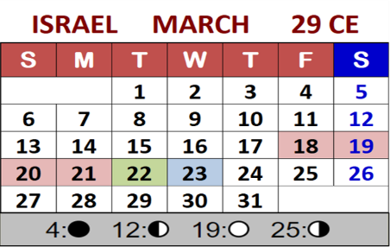

John 7 Part 5
Are
“Intercalation
Calendars”
part of Covenant?
Notes:
Taught June 3/23 by Charlene & Tim: 1 hr 45 min with exposure of many counterfeit calendars.
5.13 John 7 Pt 5 “Are Intercalation Calendars” part of Covenant” website:
5.13 Youtube launched on:
Blurb: Part 4 of this series demonstrated that when the “waiting days” are added to the end of month 6, and the 7th month begins the day after the fall equinox, this moves the Sukkot dates forward a full 7 days. As a result, the 1st day of the “re-calculated” Sukkot Sabbath precedes the 1st Lunar Sukkot sabbath by only 2 days. Yes, Yahusha does “go up” to the lunar feast at the middle of the week, but now it also appears that He is also attending an alternate Sukkot festival as well. Both Sukkot festivals cannot be correct, so why does it seem that Yahusha is supporting both of them? Is there something else going on that we are overlooking? The Lunar Sukkot is part of a calendar that uses the moon and intercalation. Covenant Calendar does not use the moon to dictate any part of calendar counting, but … will we find that the Torah Covenant Calendar should be using intercalation and still be part of everlasting covenant? “Come and See” if this teaching answers some of these questions. Shalom!

Slide 2





We have heard many times:
“When it comes to learning Covenant Calendar,
I only want the truth!
I do not want to hear about the
counterfeit calendars, or that moon,
and all that stuff!
Just give me the truth!”
And we wholeheartedly agree!
BUT, is that possible when
Covenant Calendar studies reach deeply into the Gospels where Yahusha deals with so much controversy and unbelief?

Slide 3

John 7 started out with 3 important parts!
WE LEARNED THAT HIS TIME WAS HIS PASSOVER – NOT THE JEWS’ SUKKOT!
IT APPEARS JOHN 7 ALSO HAS SOMETHING VERY
DIFFERENT TO ADDRESS!
John 7 was definitely addressing the
sunset/lunar calendar
of the unbelieving Jews.
Could there be more
to search for?
Could it be laying
just beneath the surface?
Might this be something
even more important?

Slide 4
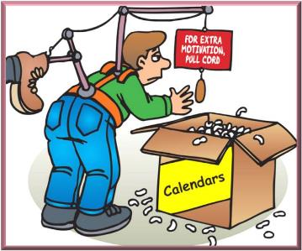


This next section is the hard part.
We must take a very brief look at some calendars that use intercalation – every one of them are counterfeit calendars.
This must be done to answer the question that was addressed in Part 4: “Why aren’t the 5, 6 or 7 waiting days placed at the end of month 6, so
Feast of Trumpets will align with the summer shadow sign (or fall equinox)”?
Summer Teshuva (a turning)

Slide 5
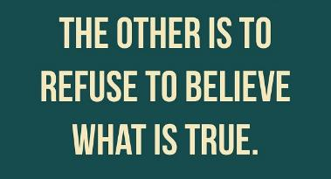

There are two ways to be fooled!
If you cannot discern
and believe the true
Covenant Calendar
of the Torah …
you could be
deceived to believe
in counterfeit calendars
that look like they are true,
BUT
they are NOT!

Slide 6
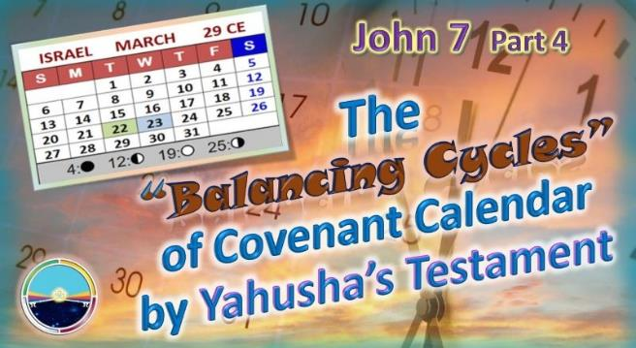


In John 7 Part 4 we tried adding the extra balancing days
to the end of the 6th month (of Covenant Calendar count),
leaving the summer shadow cycle (teshuva) as the last cycle of summer, separate from Feast of Trumpets.
In turn, this decision advanced
the Covenant Calendar 7th month Feast Dates seven cycles later.
Let’s review the 7th month count when the balancing days were added at the end of month 6.
https://studythecalendar.com/5-9-5-12-john-7-yahusha-the-jews-feast-of-tabernacles/
https://youtu.be/iiNefmoZPOM

Slide 7

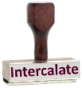
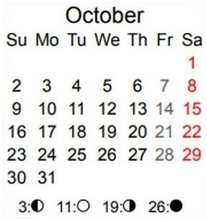

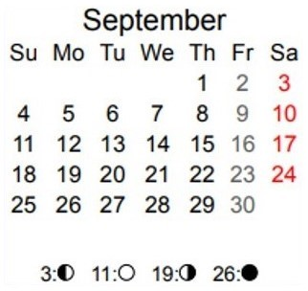
Something to remember!
Covenant Sukkot Dates
False Sukkot Dates
(Intercalated)
REVIEW
Lunar Sukkot
Lunar Sukkot
Israel 29 CE 7th Month
Israel 29 CE 7th Month
6 Waiting Days
Sep 25 Fall Tequfah

Slide 8
Something to think about!
Because Yahusha was travelling to Jerusalem, and He did not arrive until the midst of the lunar sukkot [15th], why did He not choose to arrive on time to attend the intercalated 1st adjusted sukkot Shabbat on Oct 10th since it is so close to lunar sukkot anyway? What would have been His reason?
REVIEW
Israel 29 CE 7th Month

Slide 9

And, something else to think about!
With the intercalation,
it definitely appears as if Yahusha has intended to honor the lunar Sukkot! However, we know that Covenant Calendar has no lunar connections in Torah
or the rest of Scripture.
So is it possible for our Messiah to endanger His Covenant by endorsing a full counterfeit lunar festival?
REVIEW
Israel 29 CE 7th Month

Slide 10
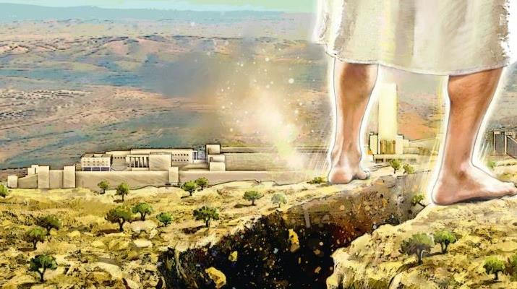
John 7:14 records: “… about the middle of the feast Yahusha went up into the temple and taught.”
Question #1:
If Yahusha was already at the lunar sukkot according to the intercalation dates, then why did John record “He went up”?
Question #2:
Where did He GO, - if -
He was already there?

Slide 11


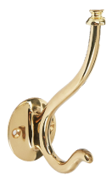
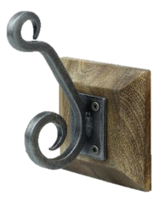
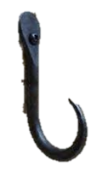
When the feasts for both the lunar and Covenant calendars were placed
on the 29 CE Roman calendar …
REVIEW
#1 Truth
Hook
… the results appeared to be suspicious!
#2 Doubt
Hook
#3 Error
Hook

Slide 12



#1 Truth Hook ?
What are
the choices
for these
two hooks?
The ‘waiting days’ are calculated according to Covenant Calendar guidelines found in Torah & the Gospel ministry of Yahusha?
REVIEW
#1 Truth
Hook
#3 Error Hook ?
The “waiting days” follow patterns found in the counterfeit calendars? Like what?
#3 Error
Hook

Slide 13

REVIEW
The choice was narrowed down
to the
#2 Doubt Hook!
#2 Doubt
Hook

Slide 14
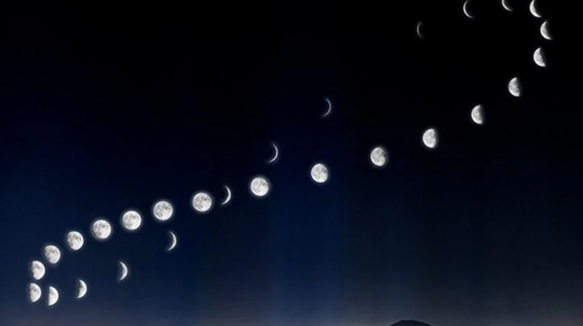
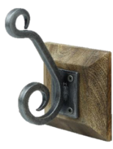
What is this “Hook of Doubt”?
REVIEW
Where is the Scripture for
a change of pattern?
Is it not declared in Amos 3:7…
“Surely Yahuah our Elohim will do nothing, but he revealeth his secret
unto his servants the prophets.”
#2 Doubt
Hook
In order to find the full truth in the Scriptures a diligent search must be made “line upon line; precept upon precept” (Isa 28:10).

Slide 15
This “Hook of Doubt” can include:
partial teachings that appear to be truth,
but they are NOT!
REVIEW
In part 5, the theory to move the “waiting days” to the end of the
6th Covenant Calendar month hangs
on a “Doubt Hook” very securely.
What is it?
#2 Doubt
Hook

Slide 16
Intercalation!
This Hook of Doubt is called:
(So called) Logical Reasoning is Used to Implement “INTERCALATION” like this:
#2 Doubt Hook
The Abib feast count begins in the
1st month the day after the Winter Shadow Sign.
So shouldn’t Feast of Trumpets ALSO begin
the day after the Summer Shadow Sign?
It sure sounds good!

Slide 17



We started out
with this ~
Why is it that nearly every festival calendar used to count the set-apart appointments must incorporate
“intercalation” somewhere?
Perhaps there should be a preview
of some of these calendars?
17

Slide 18


There are 3 basic categories to consider:
Gregorian Calendar intercalates a
“leap day” every 4 years. (No further details in this study.)
Lunar Based Calendars intercalate a
“leap month” every 3 years.
Dead Sea Scroll Calendars intercalate a
“leap week” every 7 years. [Enoch, Zadok, Essene]
Why does the everlasting
blood-ratified Covenant Calendar
NOT follow this pattern?
18

Slide 19
What about this question?
Can calendars that use intercalation ever be
“in covenant” with Torah?
Will these intercalation calendars “hang around” the “hook of doubt”?

Slide 20
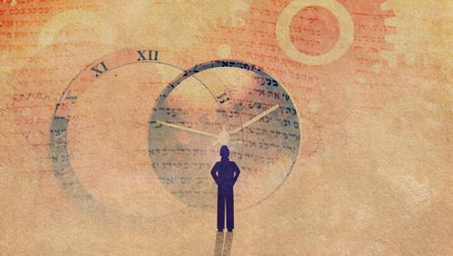


What does
intercalation
mean?
intercalate
verb
Save Word
To save this word, you'll need to log in.
Log In
in·​ter·​ca·​late | \ in-ˈtər-kə-ˌlāt \
intercalated; intercalating
Definition of intercalate
transitive verb
1: to insert (something, such as a day) in a calendar
2: to insert or position between or among existing elements or layers
Intercalation or embolism in timekeeping is the insertion of a leap day, week, or month into some calendar years to make
the calendar follow the seasons or moon phases. Lunisolar calendars may require intercalations of
both days and months.
Wikipedia
20

Slide 21

Intercalation is likened to a calibration process.
When a calendar is not correctly fulfilling the seasonal appointments, (both physical and Spiritual), it must
then be re-calibrated so it can continue for a term.
That term will be judged by man to operate within
man’s acceptable erroneous state of failure.
Counterfeit calendars constantly need recalibration
to offset man’s inherent failures to force counterfeit counts to – APPEAR AS –
Yahuah’s Qodesh Appointments.
21

Slide 22
So it appears
intercalation calendars
are hanging on the
Hook of Doubt?
For those that are unable to make
a decision, the Scriptures do have “hooks” to hang your ‘hat of doubt’ on
if that’s what you want!

Slide 23
Where is intercalation
found?
Intercalation is found in every festal calendar that uses the moon!
How can these
calendars be identified?
23
What are the names
of these calendars?

Slide 24


The Gregorian calendar is a CIVIL calendar that all of us function on for everyday civil appointments of life.
It must intercalate a “leap day” every four years.
ALL of the other calendars are
“intercalary festal calendars” that use (or recognize) their “defeated” moon in one form or another.
These moon based calendars are generally listed as:
Luni/Solar & Lunar Sabbath (variations)
Enoch, Zadok & Essene (many variations
from the Dead Sea Scrolls to be exposed soon)
24

Slide 25

Why is it that every “intercalation festal calendar” uses the moon? Did you know that?
Does the enemy have an agenda to twist
Yahuah’s perfect circuit pattern; to alter
the pattern of the qodesh festal schedule?
Is the moon part of that twisted agenda?
Has the enemy convinced the majority
his twisted agenda is in the Scriptures?

Slide 26


Amos 3:7 Surely Yahuah our Elohim will
do nothing, but he revealeth his secret
unto his servants the prophets. KJV
Where in the Scriptures does Yahuah declare the moon is part of His festal calendar?
Did He forget to reveal the
moon secret to His People?
I think the ALTERATION PATTERN CHARATERISTIC OF SATAN needs to be brought out. It’s the TWIST characteristic that reveals the power behind the system.
Alter the PATTERN of the circuit!
Alter the Pattern OF THE FESTAL SCHEDULE!
You shall NOT SURELY DIE! (Eden)
The snake retains his skin.
Yahuah declared He will do NOTHING , BUT He will tell His people!
WHERE IS THE COMMAND TO ADD 6 INTERCALARY DAYS ON MONTH SIX? Or was Yahuah joking when He said that?
Yahusha forgive me for writing that, even in the light that it needs to be said.

Slide 27
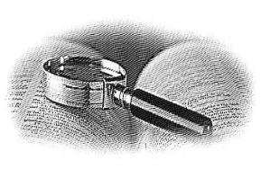
What About These
Other Festal Calendars?
When the Scriptures expose counterfeit festal calendars,
IT IS the duty of Yahuah’s Covenant Calendar to expose the deceptions! (Eph 5:11)

Slide 28

What …
about a reminder of the command in Eph 5:11?
And have no fellowship with the unfruitful
works of darkness, but rather reprove them.
Expose this darkness!
Isa 58:1 -
Cry Aloud
Rom 13:12 The night is far spent,
the day is at hand: let us therefore cast off the works of darkness, and let us put on the armour of light.
Also!

Slide 29


Let’s go
snooping on the
internet to see what
we can find!

Slide 30
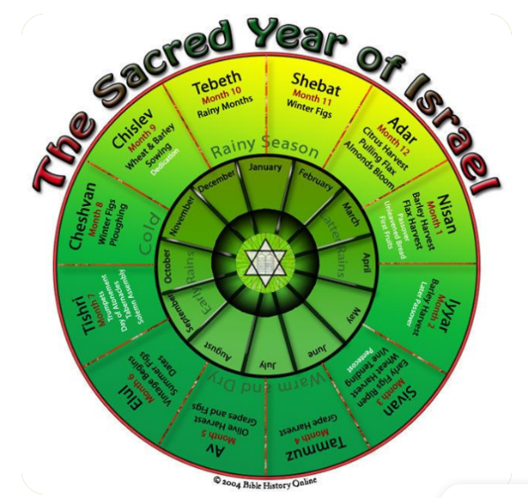
Internet Snooping
Why did the calendar change when Jesus was born?
Bede found himself with several calculations he did not approve of, and decided Christ must have actually been born on Dec. 25, 1 B.C.. By his reasoning, in other words, the A.D. system began a year after Jesus' purported birth.
Here’s a surprise from the internet today:
What is the first hour of the day in the Bible?
Jews begin their religious holidays in the evening,1 and the biblical text mandates that the two most important religious feasts, the Passover2 and the Day of Atonement,3 begin at sunset. However, in recent years, many scholars have begun to favor a different view: the day begins in the morning at sunrise.
What calendar does Israel use?
The Jewish calendar, derived from the ancient Hebrew calendar, has remained unchanged since about AD 900. It is the official calendar of the modern state of Israel and is used by Jewish people throughout the world as a religious calendar. [This may be true since 900 CE, but what happened before that? We shall see!]
Do Jews have different calendars?
The Jewish calendar is lunisolar—i.e., regulated by the positions of both the moon and the sun.
It consists usually of 12 alternating lunar months of 29 and 30 days each (except for Ḥeshvan and Kislev, which sometimes have either 29 or 30 days), and totals 353, 354, or 355 days per year. [This is partly true. Internet forgot to mention the intercalation of the moon month every 3 years.]
Study from the Scriptures, not the internet!

Slide 31

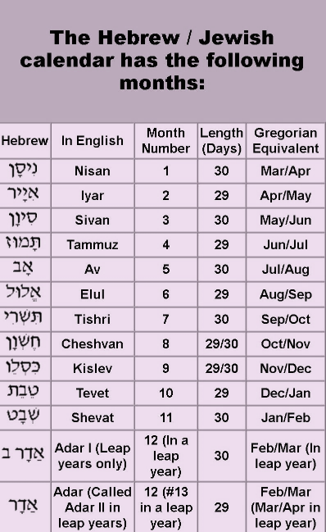
#1 Lunar Intercalation ~
adding an extra month
to every 3rd year
Noah??
This lunar calendar, (held in high regard by Hebrew Roots and Jewish communities), must add an extra month to the calendar about every 3 years to stay in alignment with the seasons. Meton fine-tuned this Babylonian idea.
Every 3rd year, Adar II is added.
Scripture support: None!
31

Slide 32
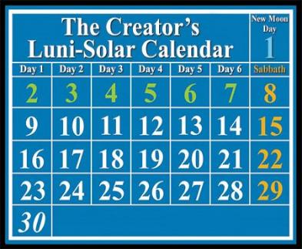
#2 Lunar~Sabbath
Intercalation ~
Sabbaths fixed to dates
All lunar-Shabbat calendars: 1) do not count the 1st day of the month; 2) fix the weekly Sabbaths to the 8th, 15th, 22nd & 29th cycles of
the lunar month coinciding the 4 main lunar phases.
One week each month will have more than
six working days before a Shabbat.
No one can decide if the months begin with either the conjunction, 1st crescent or full moon.
Scripture
support:
None!
32

Slide 33

Have you
noticed …
When the
moon is
involved
there is nothing
but problems?

Slide 34
The Ancient Dead Sea Scroll Calendar: AND THE PROPHECIES IT REVEALS Paperback – March 5 2020 by Ken Johnson (Author)
The Dead Sea Scrolls speak about a mysterious 364-day solar calendar used by the ancients from the time of Creation to about 170 BC. In the second century BC, it was replaced with a lunar calendar by corrupt Jewish priests. Today we know this corrupt lunar calendar as the modern Jewish calendar. In this book we will learn about God’s original solar calendar and discover what prophecies it reveals. Most Christians know that the Jewish festivals teach prophecy. Festivals like Passover, teach about the First Coming of the Messiah. The fall festivals, Trumpets, Day of Atonement, and Tabernacles, prophesy about the Second Coming and the Millennial Reign. The Dead Sea Scrolls reveal summer festivals that were deliberately hidden from us and point to the Age of Grace. Two of these festivals are the Festival of New Wine and the Festival of New Oil. Learn about these prophetic festivals and how to start using the original calendar God gave us.
In this next section we will examine
the Dead Sea Scroll calendars that are
considered “solar” – not “lunar.”
All of them intercalate:
Extra days during the year
An extra week when necessary
There are differences even among
these major similarities.
Various examples will be addressed during this section
ALSO exposing the lunar component!

Slide 35
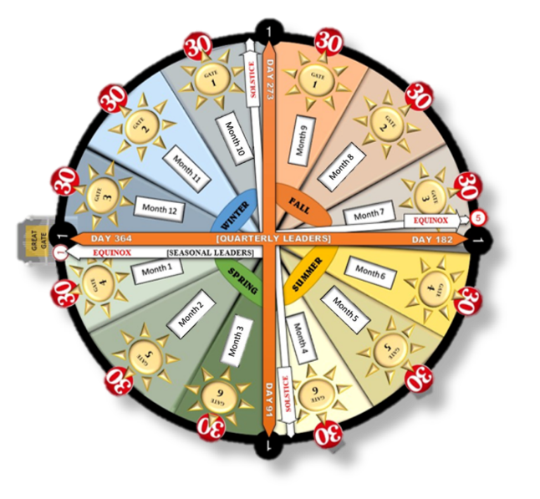
Internet Snooping
www.REMNANTofthelight.net
What is the Zadok priestly calendar?
The Zadok Priestly Calendar uses the Torah, Prophets, & New Testament in collaboration with Enoch, Jubilees, and other documents found in the Dead Sea Scrolls, recorded in great detail by the Sons of Zadok, descendants of Aaron, the High Priest. This allows the Moedim to never fall on a weekly Sabbath, confirmed with David’s 52 Sabbath Psalms, found in the Dead Sea Scrolls.
Months are based on the counting of the chodesh (Hebrew for month), using the sun, moon and stars as a guiding witness. This is contrary to the common use of the new moon used for determining the start and length of the months.
[Practically the same as the Enoch and Essene calendars using the 364 day year, and the month count of 30-30-31. This calendar also acknowledges the priestly courses, stemming from Zadok the priest, as the authority this must be the correct calendar.]
Do the Scriptures support
a calendar from Zadok?

Slide 36
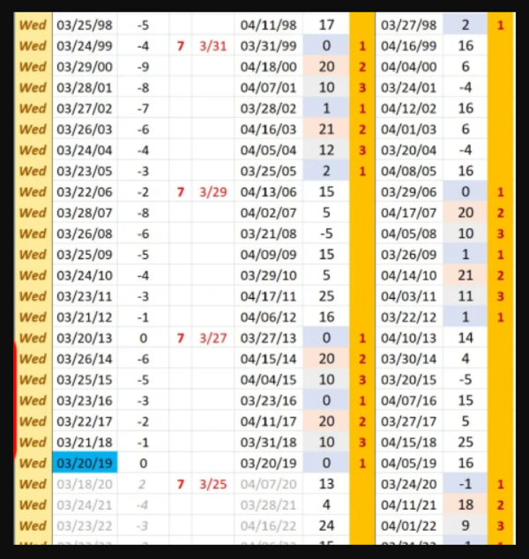
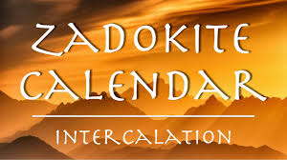
This is the website, and I didn’t know the moon was used so much in this calendar – it’s unreal.
https://torahislight.org/intercalation/
Calendars that teach a 364 day year from the beginning of Gen 1 are not in alignment with Torah. Noah’s record of the flood account shows there are no extra days added at the end of the 3rd and 6th months, nor is it necessary to add in an extra week every 7 years (as shown by the markers), or have any days counted as “non-days.”
36
https://en.wikipedia.org/wiki/MUL.APIN
May 21/23 – some information on mul-apin tablets:
Tablet 2[edit]
The second tablet is of greater interest to historians of science as it furnishes us with many of the methods and procedures used by Babylonian astrologers to predict the movements of the sun, moon and planets as well as the various methods used to regulate the calendar. The contents of tablet 2 can be summarised under ten headings as follows:
The names of the sun and the planets and the assertion that they all travel the same path as the moon.
Which stars are rising and which contain the full moon on the solstices and equinoxes in order to judge the disparity of the lunar and solar cycles.
Recommendations for observing the appearances of certain stars and the direction of the wind at the time of their first appearance.
Very approximate values for the number of days that each planet is visible and invisible during the course of its observational cycle.
The four stars associated with the four directional winds.
The dates when the sun is present in each of the three stellar paths.
Two types of intercalation scheme. One uses the rising dates of certain stars while the other uses position of the moon in relation to the stars and constellations.
The relative duration of day and night at the solstices and equinoxes, and the lengths of shadow cast by a gnomon at various times of the day at the solstices and equinoxes.
A basic mathematical scheme giving the rising and setting times of the moon in each month.
A selection of astrological omens.

Slide 37
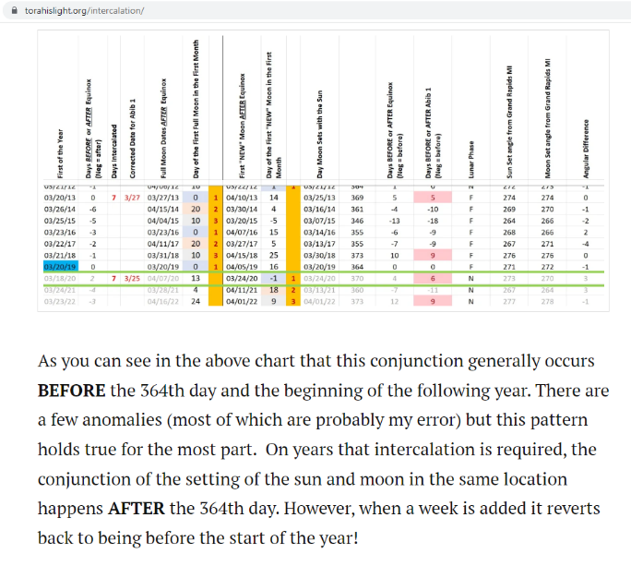
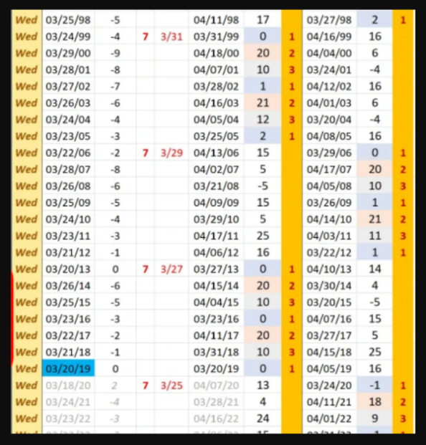
This factor is in direct opposition to Gen 1:14 – SHANEH!
What does the author have to say about all of this?

Slide 38
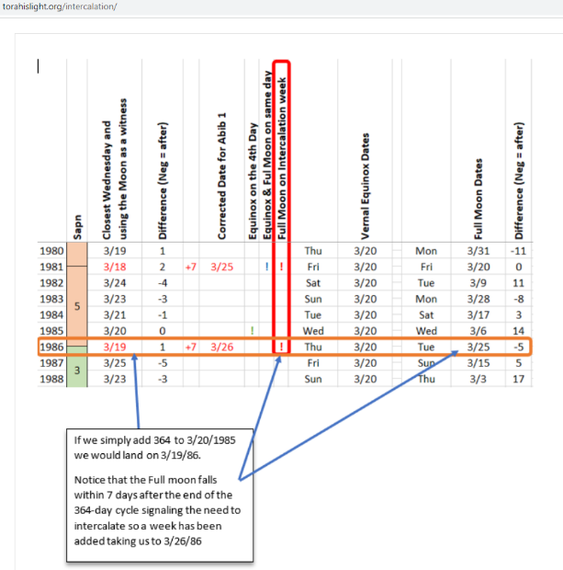
Notice it is the moon phase that
SIGNALS THE DETERMINATION OF TIME!

Slide 39
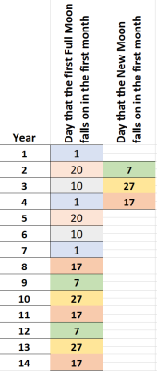
After the author had described 2 other methods of intercalation, he settles on Method #3:
“We can see that in the 1st year the full moon falls on the 1st day of the year, the second year it falls on the 20th, 3rd year the 10th, 4th the 1st, 5th year the 20th, 6th year the 10th and the 7th year it again lands on the 1st.
“So it develops a 1, 20, 10, 1, 20, 10, 1 pattern for the full moon dates.
The pattern for the new moon is the 17th, 1st, 7th, 27th and so on. If we intercalate on the first year of every sabbatical cycle the pattern actually
shifts between the two patterns. This happens pretty much without fail
and also keeps us within a week of the spring equinox. What is harder to determine is when the additional year of intercalation that has to happen
on or around the 28th year must take place.
“Since we are only given 4 years of full moon dates and 3 years of new moon dates we have to do a little interpolation, but the moon is pretty consistent running on a 19 year metonic cycle. Knowing this is helpful indeed because once we isolate the patterns we can determine with a fair amount of accuracy years into the past or future when the lunar phases will actually land.
https://torahislight.org/intercalation/
39

Slide 40

“We are still testing this pattern out to see if it does hold true. What is interesting is that for 2020 the moon actually sets in the same place (within 3 degrees) as the sun on the 24th of March further supporting Enoch and the possible need to intercalate for that year. …
“This method does have some problems as they all do, but it definitely holds closer to the recorded information that we have in the Scrolls than the other methods do.
“I realize that these are not the majority views concerning intercalation, however, one cannot simply disregard the moon or the stars when looking at the calendar. These heavenly bodies were given for signs, moed (appointed times), days and years. It is NOT just a solar calendar and I personally believe after spending a great deal of time with this, Enoch is absolutely correct when he says, “The moon brings on all the years exactly, that their stations may come neither too forwards nor
too backwards a single day; but that the years may be changed with correct precision …” ”
“Regardless, this calendar definitely appears to be established primarily upon the WORD of Yah and then confirmed by the witnesses, not the other way around; and that pattern makes the most logical sense to me from a scriptural standpoint.
“All alignments aside there are still several issues regarding intercalation that have not been made clear. Unfortunately there is no published record of how the Zadok priests actually intercalated, or if they even did for that matter. Therefore understanding how this effects the priestly courses and the beginning of the year is no easy task.
“So for now we are simply waiting on Yah to provide an answer.”
The author concludes by saying this calendar was accepted by casting lots, and that’s good enough for him.
40

Slide 41
Zadok Intercalation ~ adding an extra
week to the year
https://torahislight.org/intercalation/
The Zadokite Calendar, (along with several of the other DEAD Sea Scroll calendars), must also add an extra week to their calendars every 7 years to stay in alignment (or re-calibrate) with the seasons.
Scripture support: None!
41

Slide 42
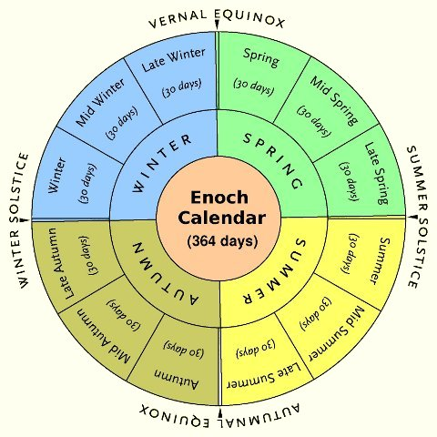
Internet Snooping
The Enoch calendar is an ancient calendar described in the pseudepigraphal Book of Enoch.
It divided the year into four seasons of exactly 13 weeks. Each season consisted of two 30-day months followed by one 31-day month, with the 31st day ending the season, so that Enoch's year consisted
of exactly 364 days.
The Enoch calendar was purportedly given to Enoch by the angel Uriel. Four named days, inserted as the 31st day of every third month, were named instead
of numbered, which "placed them outside the numbering." The Book of Enoch gives the count of 2,912 days for 8 years, which divides out to exactly 364 days per year. This specifically excludes any periodic intercalations. [Notice, no mention of the
7 day intercalation every 7 years!]
Scripture study is not from Enoch!

Slide 43
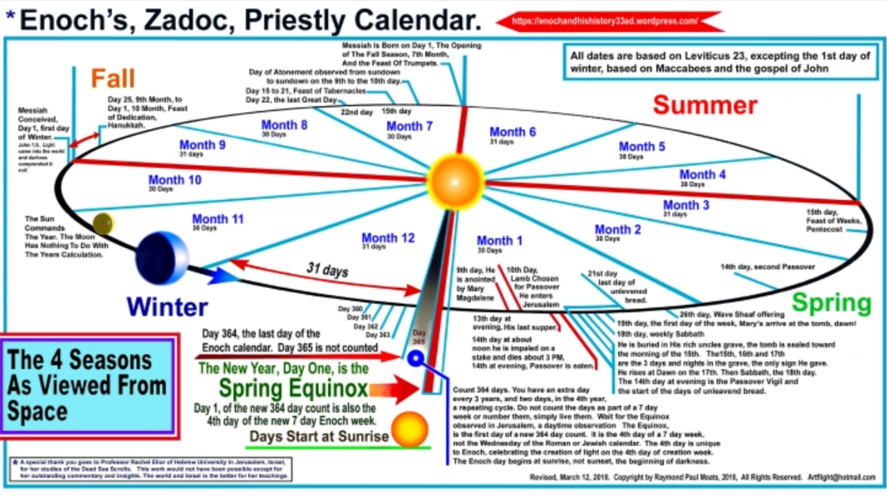
From Tim May 20/23
Interesting. Not a Wed, does this mean it is like the lunar shabbat, is can be at anytime?
CF: I don’t know exactly what the quote means … saving this box if we figure it out.
*[Both are cousin calendars to the Essene Calendar.]
Scripture support: None!
The Sun Commands The Year. The Moon Has Nothing To Do With The Years Calculation.
[Is this true?]
Gen 1:14 – Shaneh - eliminated!
Count 364 days. You have an extra day every 3 years, and
2 extra days in the 4th year, a repeating cycle. Do not count the days as part of a 7 day week, or number them, simply live them. Wait for the Equinox observed in Jerusalem, a daytime observation. The Equinox, is the first day of the new 364 day count. It is the 4th day of the 7 day week, not the Wednesday of the Roman or Jewish calendar. The 4th day is unique to Enoch, celebrating the creation of light on the 4th day of creation week. The Enoch day begins at sunrise, not sunset, the beginning of darkness.
43

Slide 44
Enoch/Zadok Intercalation
https://en.wikipedia.org/wiki/Enoch_calendar
Calendar expert John Pratt wrote that "The Enoch calendar has been criticized as hopelessly primitive because, with only 364 days, it would get out of sync with the seasons so quickly: in only 25 years the seasons would arrive an entire month early. Such a gross discrepancy, however, merely indicates that the method of intercalation has been omitted."^{[1]} Pratt pointed out that by adding an extra week at the end of every seventh year (or Sabbatical year), and then adding an additional extra week to every fourth Sabbatical year (or every 28 years), the calendar could be as accurate as the Julian calendar.
And LOOK what he proposes next:

Slide 45

Enoch/Zadok Intercalation [con’t] has the “math formula”!
There is some evidence that the group whose writings were found at Qumran used a variation of the Enoch calendar (see Qumran calendar).
Web link: https://en.wikipedia.org/wiki/Enoch_calendar
If the Torah had a math formula like this, how many people would be excited about learning and following such a Covenant Calendar? Compare to: Matt 11:30
“For my yoke is easy, and my burden is light.”

Slide 46
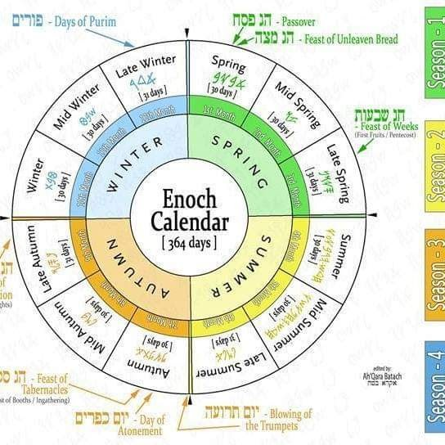
Enoch Intercalation ~
adding an extra day every 3rd month
Supposed to be written by “an” Enoch, these calendars (from the DEAD Sea Scrolls), claim the year has only 364 days, with each quarter having 91 days.
An extra day is added at the end of
every 3rd month for a count of 30-30-31.
(This system is DESTROYED by the flood account
with Noah, Joshua entering into Canaan, and
the Mul-Apin Tablets of the Babylonian region!)
However, does this really solve any problems?
What about the literal year that has 365 days,
and, 366 on every leap year?
Scripture support: None!
46

Slide 47
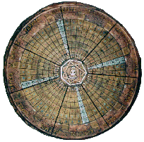
Internet Snooping
What is the Essene Calendar [& Passover Dates]?
The point of the analysis [on the next slide] is to illustrate that
only in A.D. 30 did the Essene Passover Eve fall 1 day before the Jewish Passover Eve. In all other years the Essene Passover Eve fell in a different week or fell after (not before) the Jewish Passover.
Consequently, A.D. 30 is the only year in which Jesus and His disciples could observe the Essene Passover exactly one day before the Jews and Pharisees etc. observe the Jewish Passover, and hence A.D. 30 is the only year in which Jesus could both observe Passover in the upper room and then Himself be the sacrificial Passover Lamb of God the following day on Jewish Passover.
No other year satisfies all the criteria to harmonize the gospel Passion Week accounts, and hence A.D. 30 stands alone as
the only "fit" for the year of crucifixion.
Note that key anchor dates are highlighted in:
Essene Passover Dates (from the top of this page)
The point of the analysis[on the next slide] is to illustrate that only in A.D. 30 did the Essene Passover Eve fall 1 day before the Jewish Passover Eve. In all other years the Essene Passover Eve fell in a different week or fell after (not before) the Jewish Passover.
Tim, then the 2nd para. falls flat on its face ... as they have Yahusha dying on the jews' passover day - but it is a close counterfeit for sure. The jews' passover is on thursday - not the midst of the week in 30 AD. Essene's have tuesday passover, so it appears there is a lot of guesswork here - claiming Essene tues PO, and Jewish Wed PO in 30 AD, which is impossible according to the lunar cycles. It's all garbage but people believe this stuff because they do not check the lunar cycles. I'll save this evidence in part 4 - just in case we need to point out these problems. read on ...
Consequently, A.D. 30 is the only year in which Jesus and His disciples could observe the Essene Passover exactly one day before the Jews and Pharisees etc. observe the Jewish Passover, and hence A.D. 30 is the only year in which Jesus could both observe Passover in the upper room and then Himself be the sacrificial Passover Lamb of God the following day on Jewish Passover.
No other year satisfies all the criteria to harmonize the gospel Passion Week accounts, and hence A.D. 30 stands alone as the only "fit" for the year of crucifixion.
Do the Scriptures support
the Essene calendar?
Let’s
see!
Essene Passover Dates
The point of the analysis below is to illustrate that only in A.D. 30 did the Essene Passover Eve fall 1 day before the Jewish Passover Eve. In all other years the Essene Passover Eve fell in a different week or fell after (not before) the Jewish Passover.
Consequently, A.D. 30 is the only year in which Jesus and His disciples could observe the Essene Passover exactly one day before the Jews and Pharisees etc. observe the Jewish Passover, and hence A.D. 30 is the only year in which Jesus could both observe Passover in the upper room and then Himself be the sacrificial Passover Lamb of God the following day on Jewish Passover.
No other year satisfies all the criteria to harmonize the gospel Passion Week accounts, and hence A.D. 30 stands alone as the only "fit" for the year of crucifixion.
AM - Latin ante meridiem, meaning literally "before midday", i.e. morning or before noon
M - Latin meridies, meaning literally "midday", i.e. noon
PM - Latin post meridiem, meaning literally "after midday", i.e. afternoon or evening
MN - Latin media nox, meaning literally "midnight“
* add 2 hours to convert UTC/GMT to Jerusalem timezone using US Naval Observatory data
** Assume Essenes "set" their calendar to 1 Nisan Wednesday on the Vernal Equinox:
The differences in which day of the week Passover was observed between the Essenes and the Jews (Pharisees, Sadducees, etc.) is due to their different practices in starting their respective annual calendars. The Fourmilab Calendar Converter determines Hebrew dates according to the Jewish method and Hillel II rules. But that same converter does not compute Essene dates - we must do that ourselves:
Enter the Vernal Equinox (VE) date (already Julian) determined by USNO into the Fourmilab Calendar Converter Julian input, and then "calculate".
Readout the ISO-8601 day of year VE date (converted from the Julian VE)
Add 13 days to ISO-8601 VE date and calculate again
(Because Essene new year on Nisan 1 + 13 days => Essene Passover Eve on Nisan 14)
Readout the Julian & Gregorian equivalent dates for Essene Passover Eve
(Note that we ignore the weekdays and the Hebrew conversion readout because the Essene & Hebrew calendars are different, and the converter does not compute Essene calendrics.)
An Essene Passover?
It is speculative and questionable that John the Baptist was an Essene, but it is now generally recognized that prior to the crucifixion of Jesus, there were Essenes in Jerusalem, the "upper room" was likely located in an Essene quarter of Jerusalem, the Essenes were the likely inhabitants of Qumran, and the Essene/Qumran calendar was a 364 day solar calendar at odds with the calendrics of the Sanhedrin:
As recently as 2007, Magen Broshi concludes:
It is well nigh certain that Palestinian Judaism in the last two centuries of the Second Commonwealth was divided into three religious movements (or parties). There is absolutely no need to change the reigning theory—Qumran must have been an Essene community. ... [and of the] ca. 100 scholars who deciphered, read, commented upon and published the Scrolls. Hardly any of them expressed doubts about the Essene identification. [pp. 32-33]
Magen Broshi (of the Israel Museum), "Essenes at Qumran? A Rejoinder to Albert Baumgarten",
Dead Sea Discoveries, Volume 14, Number 1, 2007 , pp. 25-33
Edward L. Cohen explains that the Essenes understood the problems with the 354-day lunar calendar, and generally used their 364-day solar calendar instead:
As far the calendar, the Essenes actually had two of them. The first one, from the scrolls, was a lunar one. It had 354 [= 6x(29 + 30)] days. As we indicated, the moon goes around the earth in approximately 29 1/2 days; that is why we get this peculiar number of days. Since the holidays came from the second one, not much else is gleaned from the 354-day calendar. The second is much more complicated. It had 364 days and was solar. Since 3x354 + 30 = 3x364, it is thought that an extra month of 30 days was added to the lunar one every three years (at the end of the three years) to make up for the difference to keep everything normal. See [EW:§§22-23] for translations of plates 4Q321, 4Q320 from the Hebrew, which delineate the equivalences. We now know that the solar (364) calendar was the mainstay with the luni-solar (354) calendar playing a much lesser role. [EW:1O8] indicates that the Essenes kept track of the luni-solar only to point out errors in case they would eventually be in charge in Jerusalem. 4QMMT [QSl, QS2, QS3, SH2:173-174] also points to a 364-day calendar. Yadin found evidence [YN1:173] that the same calendar was used by those at Masada, thus perhaps linking the two sects. In fact, while excavating, he found the Book of Jubilees, which will be discussed later, in its original Hebrew text [PM:186-189]. (p5-6)
In essence, the Jubilee calendar was the one used by the Qumran sect: surveys of this can be found in [FL:146-156] although no mention of the intercalation is mentioned; and in [VP:126-l30]. In the latter, the author notes [VP:129-130]:
"One can ask one self whether the refusal of the community to celebrate the common Jewish feast-days at the same time as the rest was not the most decisive reason for the formation of the sect. No certain answer can be given, because it is so difficult to determine the history of the community and the motives of their conduct as long as our data are incomplete." (p7)
Edward L. Cohen, "Calendars of the Dead-Sea-Scroll Sect",
CUBO Matematica Educacional, Vol. 5, No- 2, (1-16). JUNIO 2003.
Bargil Pixner reports that Essenes lived in Jersusalem in Jesus' time:
I believe we now have sufficient evidence not only to identify our gate as the Gate of the Essenes but also to conclude that a community of Essenes lived here on Mount Zion in Jesus' time.
Bargil Pixner, "Jerusalem’s Essene Gateway - Where the Community Lived in Jesus’ Time",
Biblical Archaeology Review, Volume 23 Number 3 May/June 1997, p4
Sidnie White Crawford argues that relative to rabbinic Judaism, the Qumran residents were a subset of a broader Essene population:
Qumran, therefore, was not the only Essene settlement in Judea, but rather a large Essene center. In support of this, we know that there were Essenes active in Judea at large. For example John the Essene was a leader in the Jewish Revolt. [p. 32]
The weight of agreement between the classical sources and the scrolls makes the equation of ‘Qumran settlers = Essenes’ highly probable. [...] It does not seem reasonable to scrap the identification of the Qumran sectarians as Essenes, when there is such substantial correlation between the scrolls and the classical sources, because we have new evidence that doesn’t quite fit the old definition. Instead, what is needed is an expansion of the term ‘Essene.’
I would suggest that the group of Jews who inhabited Qumran may have evolved over time, from a group with deep roots in Palestinian Judaism, who split with other Jews over such disputed things as law and calendar, to a sect with highly developed doctrines of, for example, predestination and angelology, which set them apart from other Jews. This is the group that Josephus is describing. Therefore, I would argue for the continuing identification of the Qumran sectarians with the Essenes. [pp. 32-33]
Finally, the group at Qumran, which we have identified as the Essenes, appears to have deep roots in Palestinian Judaism, adopting ideas cherished earlier in Palestine, in particular the solar calendar. Evidence for this is found in the prevalence of books such as I Enoch 72-82 (the Astronomical Book) and Jubilees (14 copies) from the early phase of habitation at Qumran. [p. 34]
Sidnie White Crawford, "Response to “New Documents: Qumran and Gnostic Writings' by Joseph A. Fitzmyer, Jr."
Faculty Publications, Classics and Religious Studies Department, University of Nebraska-Lincoln, 1991
James A. Walther proposes (in 1958) that the Lord's Supper was a Passover observance according to the Qumran solar calendar (i.e. Essene):
The proposition in brief is this: The difficulties attendant upon the analysis of the chronology of Passion Week may be reduced by recognizing that the old solar calendar, evident in the Book of Jubilees and in Enoch, in use in Qumran, and perhaps reflected in the OT itself, may well have provided the occasion for Jesus' observance of the Passover at the time he instituted the Eucharist. (p116)
J. T. Milik in his recent monograph, Dix ans de de'couvertes dans le de'sert de Juda, mentions manuscripts from Cave IV which place the observance of the Passover on Tuesday;⁹
⁹ ... Since then Milik has published additional fragments from Cave IV bearing on the Essene calendar and its relationship to the official calendar, Supplements to Vetus Testamentum, IV (1957), 24 ff. In the current fascicle of Biblica, XXXIX/l (1958), 72-77, Vogt has taken the 4Q data and attempted to reconstruct the official calendar over against the Essene calendar. His tables demonstrate a three year cycle with a one-day-plus remainder. If this is adjusted, the fourth year will bring the official Passover in the same week as the Essene observance (as in the first year), but one day later. While the Essene Passover always falls on Tuesday evening, the official Passover would occur on Wednesday evening, the first year, on Thursday evening in the fourth year, and on Friday evening in the seventh year. (fn p117)
James A. Walther, "The Chronology of Passion Week"
Journal of Biblical Literature, Vol. 77, No. 2. (Jun., 1958), pp. 116-122. p117
Joseph M. Baumgarten accepts that the Qumran residents followed the solar calendar as described in Jubilees:
Today it is becoming increasingly evident that the calendar was actually one of the main areas of disagreement between the sect and its opponents. This is evident from the constant emphasis in our texts on the proper times and seasons and the dramatic interference of the wicked priest with the sect's observance of the Day of Atonement (1QpH 11.4-8). In addition to the explicit reference to Jubilees in CDC, the fact that the sect followed the solar calendar of that book has been inferred by Yadin from the twenty-six mišmarot (priestly courses) mentioned in 1QW. A new fragment from Cave IV describing the rotation of the mišmarot now seems to confirm this inference.Ib Since these calendaric differences involved the priesthood and the temple, it is clear that we have to reckon with the calendar as one of the major issues involved in the separation of the sect from the Pharisaic community.'. (p255)
Joseph M. Baumgarten, "Qumran Studies",
Journal of Biblical Literature, Vol. 77, No. 3. (Sep., 1958), pp. 249-257.
The point of the foregoing is not to argue that Jesus was an Essene in some fashion. Rather, the point is merely to establish the archaeological and historical background that Essenes lived in Jerusalem and Judea and observed the Old Testament feasts on a 364-day solar calendar, and establish the feasibility (and opportunity) of an Essene Passover different from the "Passover of the Jews" as John referred to it (John 2:13, 11:55).
Consequently, based on best fit of the date and upper room location, Jesus and His disciples (and company) were likely hosted by Essenes when they observed Passover, and presumably it was an Essene observance of Passover according to Essene calendar keeping that Jesus observed in the upper room with His disciples. The Essenes are also generally recognized as being the most pure and devout sect whereas by contrast Jesus characterized the Pharisees as a 'brood of vipers whose father was Satan' and the Sadducees were agitating for an unscriptural revision in Counting the Omer to the Feast of Weeks. So it is not unreasonable that Jesus would observe an Essene Passover as opposed to that orchestrated by the Pharisees' power struggles against the Sadducees (see also Two Passovers?).
So, the Passover that Jesus observed in the upper room was likely the Essene Passover and not the Jewish Passover (which was 1 day later), and we wish to ascertain how the Essenes determined Passover observances and how that compared to the Jewish Passover observances (table above).
In the Book of Enoch, there is a reference to the 1st month in which "the day becomes daily longer and the night nightly shorter" which is understood as following the vernal equinox:
In this way he rises in the first month in the great portal, which 7 is the fourth [those six portals in the cast]. And in that fourth portal from which the sun rises in the first month are twelve window-openings, from which proceed a flame when they are opened in 8 their season. When the sun rises in the heaven, he comes forth through that fourth portal thirty, 9 mornings in succession, and sets accurately in the fourth portal in the west of the heaven. And during this period the day becomes daily longer and the night nightly shorter to the thirtieth 10 morning.
Book of Enoch 72:6-10
The Essene Passover is assumed to follow Qumran practices according to the solar calendar described in the Book of Jubilees:
The proper method of marking the passage of time is the “movements” of the sun (solar calendar) (6:23-31); in fact this was one the purposes for which the sun was created (2:9). This means that the year is to be 364 days long, consisting of [4 units of] 13 weeks [including] four “days of remembrance” after the solstices and the equinoxes (see 6:32-38). This solar calendar is equally divisible by seven into fifty-two weeks, which means that the Sabbaths and the festival days will always fall on the same day of the month for every year. These four units of thirteen weeks are each divided into three non-lunar months. Since God created the sun on the fourth day, the year must always begin on a Wednesday. The festivals always fall on the same day of the week and same day of the month each year. (As already indicated, there is a probable reference to 1 Enoch 72-82 in Jub. 4:17.) The larger units of marking the passing of time are the “week” (period of seven years) and the jubilee (7 x 7 = 49 years). Throughout the Book of Jubilees, the author attempts to date all significant events by this method.
Barry Smith, "The Book of Jubilees - 2.4. Calendar"
So the Essene sacred year always began on the vernal equinox and is, by definition, Wednesday, 1st day of the 1st month (Nisan or Abib). Consequently, the Essene Passover will always begin 6 PM Tuesday, 13 days later (Nisan 14). The key point being Essene Passover always began "Tuesday" evening, 13 days after the vernal equinox. To outsiders, the Essenes would appear to observe the vernal equinox and (regardless of whatever the previous day was) declare that day to be Wednesday 1 Nisan. However, within the Essene community this would be entirely self-consistent. Their 364-day year had exactly 52 x 7-day weeks and since the vernal equinox varied by less then 6 hours one year to the next, for all practical purposes the Essenes never really adjusted their calendar - it was never off by more than a few hours and any observation errors would likely be attributed to occluded viewing conditions when the Sun's position and daytime transit duration could not be observed and measured. But to outsiders, comparing the Essene date and day of the week to other calendar systems, the Essenes would appear to be resetting their calendar to Nisan 1 every vernal equinox.
So, understandably due to different calendar keeping systems, the Essenes and everyone else would disagree on what the date was. This probably wouldn't surprise too many people as most nations and/or peoples were using different calendar systems anyway, and calendar keeping was somewhat of a high-priestly mystic craft.
Jewish observance of Passover, however, varied depending on their postponement rules. It always began evening of Nisan 14th (by the Jewish sacred calendar), but the day of the week on which Nisan 14th fell varied because the postponement rules varied when the Jewish Civil year was recognized to have begun, and thus when (6 months later) the Jewish Sacred year began.

Slide 48
Essene 30 AD Passover Dates
Essene Passover always began "Tuesday" evening,
Essene Passover always began "Tuesday" evening,
“As for the calendar, the Essenes actually had two of them. The first one, from the scrolls, was a lunar one. It had 354 days [6x 29 + 6x 30 = 354].
“The second is much more complicated. It had 364 days and was solar.
“Essenes lived in Jerusalem and Judea
and observed the Old Testament feasts on a 364-day solar calendar, and establish the feasibility of an Essene Passover different from the "Passover of the Jews" as John referred
to it (John 2:13, 11:55).”
NOTE: This is a long ways from creation in Gen 1.
 | Jerusalem Vernal Equinox* |  | Nisan 14th Passover Eve
Year | Julian dates | Essene date | Julian dates |  | Gregorian dates
AD |  |  | Essene** | Jewish | Essene** | Jewish
26 | March 22, 12 MN, Fri | Nisan 1, Wed | April 4 | March 22 | April 2, Thu | March 20, Fri
27 | March 23, 6 AM, Sun | Nisan 1, Wed | April 5 | April 9 | April 3, Sat | April 7, Wed
28 | March 22, 12 M, Mon | Nisan 1, Wed | April 4 | March 29 | April 2, Sun | March 27, Mon
29 | March 22, 6 PM, Tues | Nisan 1, Wed | April 4 | April 16 | April 2, Mon | April 14, Sat
30 | March 22, 12 MN, Wed | Nisan 1, Wed | April 4 | April 5 | April 2, Tues | April 3, Wed
31 | March 23, 5 AM, Fri | Nisan 1, Wed | April 5 | March 26 | April 3, Thu | March 24, Mon
32 | March 22, 11 AM, Sat | Nisan 1, Wed | April 4 | April 14 | April 2, Fri | April 12, Mon
33 | March 22, 5 PM, Sun | Nisan 1, Wed | April 4 | April 3 | April 2, Sat | April 1, Fri
34 | March 22, 11 PM, Mon | Nisan 1, Wed | April 4 | March 22 | April 2, Sun | March 20, Mon
35 | March 23, 5 AM, Wed | Nisan 1, Wed | April 5 | April 11 | April 3, Tues | April 9, Mon

Slide 49
Essene 30 AD Passover Dates
What is the Essene calendar [Passover Dates]?
The point of the analysis[on the next slide] is to illustrate that only in A.D. 30 did the Essene Passover Eve fall 1 day before the Jewish Passover Eve. In all other years the Essene Passover Eve fell in a different week or fell after (not before) the Jewish Passover.
Consequently, A.D. 30 is the only year in which Jesus and His disciples could observe the Essene Passover exactly one day before the Jews and Pharisees etc. observe the Jewish Passover, and hence A.D. 30 is the only year in which Jesus could both observe Passover in the upper room and then Himself be the sacrificial Passover Lamb of God the following day on Jewish Passover.
No other year satisfies all the criteria to harmonize the gospel Passion Week accounts, and hence A.D. 30 stands alone as the only "fit" for the year of crucifixion.
“Essenes kept track of the luni-solar only to point out errors in case they would eventually be in charge in/at Jerusalem.
“Essene Passover always began "Tuesday" evening.
“CONCLUSION: It is not unreasonable that Jesus would observe an Essene Passover as opposed to that orchestrated by the Pharisees' power struggles against the Sadducees.
“So, the Passover that Jesus observed in the upper room was likely
the Essene Passover and not the Jewish Passover (which was 1 day later).”
Note the serious problems with this information!
 | Jerusalem Vernal Equinox* |  | Nisan 14th Passover Eve
Year | Julian dates | Essene date | Julian dates |  | Gregorian dates
AD |  |  | Essene** | Jewish | Essene** | Jewish
30 | March 22, 12 MN, Wed | Nisan 1, Wed | April 4 | April 5 | April 2, Tues | April 3, Wed
Summary of events for these three calendars in Year 30 AD
Essenes: Yahusha observes last supper in Upper Room on Essene Passover.
Jewish: Yahusha dies on Jews’ Passover.
Covenant: Yahusha observes Last Supper on evening of Abib 13; dies on His Covenant Passover on Wed Abib 14; Jewish Passover begins at sunset on covenant Abib 14; therefore, the Jewish Passover is really on 5th cycle [Thurs] according to the calculation of the lunar cycles-not on “WED” as the Essenes claim.
Essene Calendar Calculation Problem: They may be calculating the Essene calendar correctly according to their calendar rules, but they have not taken
care to calculate the proper lunar calendar reckoning according to the Jews.
Question: Can the Essene calendar demonstrate the 12 hour offset between the Essene and Jewish lunar calendar Passover dates?

Slide 50
Essene 30 AD Feasibility Clause
 | Jerusalem Vernal Equinox* |  | Nisan 14th Passover Eve
Year | Julian dates | Essene date | Julian dates |  | Gregorian dates
AD |  |  | Essene** | Jewish | Essene** | Jewish
30 | March 22, 12 MN, Wed | Nisan 1, Wed | April 4 | April 5 | April 2, Tues | April 3, Wed
“Essenes lived in Jerusalem and Judea
and observed the Old Testament feasts on a 364-day solar calendar, and establish the feasibility of an Essene Passover different from the "Passover of the Jews" as John referred
to it (John 2:13, 11:55).”
Remember, this is a long ways from creation in Gen 1.
Was this 364 cycle calendar not yet “feasible” from creation until
Yahusha’s Passover?
Evidently Essenes do not believe Yahusha was slain from the foundation of the earth; they had to wait until the crucifixion
for validation of the Mashiach and their calendar!

Slide 51
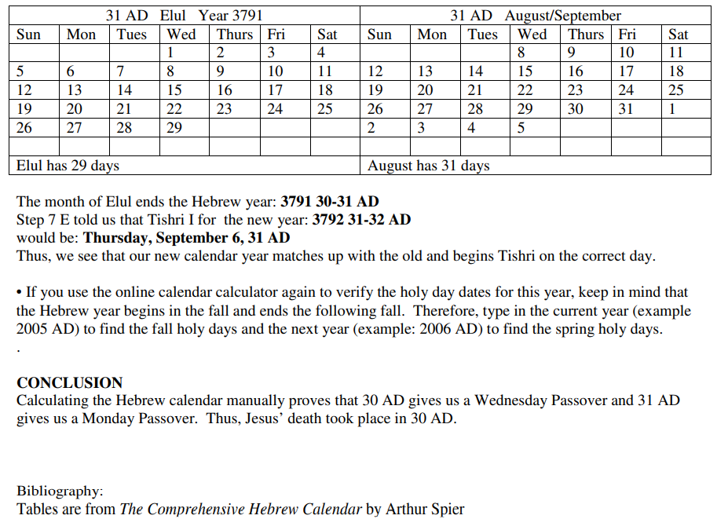
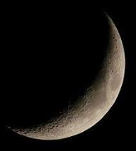
Other Documentation for 30 AD Passover
WORKBOOK FOR CALCULATING THE HEBREW CALENDAR FOR 29-30 AND
30-31 AD
(By permission of) Marie Casale
Copyright ©
Do Hebrew & Essene Calendars Align?
Article: The Moon and the Molad Calculated Calendar

Slide 52
Three Dead Sea Scroll Calendars
Charting a Simple Comparison of the Dead Sea Scroll Calendars
ZADOK | ENOCH | ESSENE
Uses its authority as the Zadok priesthood operating under king David. Some believe the Zadok priests were the same as the Melki-Tzedek Priesthood that is in operation today. | Uses its authority as the angel Uriel and also attempts to link back to the Enoch in the line of Seth. | Uses its authority as having the correct year of Yahusha’s death in 30 CE using a careful, detailed comparison from both the Julian and Gregorian calendar dates.
Month Count: 30-30-31
Year Length: 364 days
Intercalation of 1 week each 7 years.
Each calendar boasts of having a higher authority, yet all three calendars have more similarities than differences.

Slide 53
There’s one
more item to be
considered for
Enoch’s calendar.

Slide 54
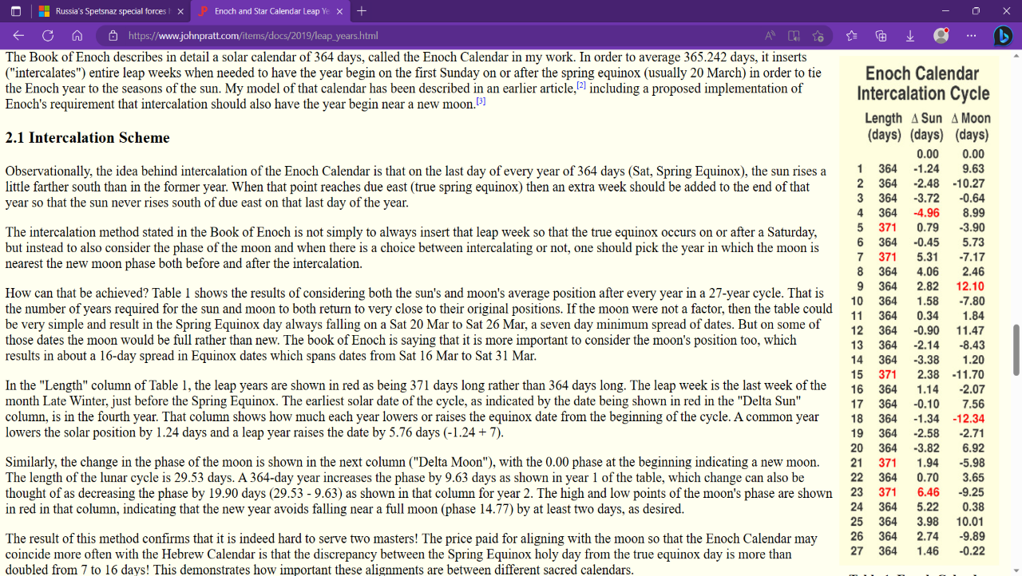
Let’s read this whole slide!
John 7:6 … your time is always ready …
What changes? Their Calendar or the Teshuva Shadow?
54
Read this para!!!!!!!!!!!! This whole slide needs to be read in detail specifically for the purpose of showing the incredible insanity of confusion. What is the difference between their two equinox days? Is it the Equilux????

Slide 55

Most of the Dead Sea Scroll calendars begin on Wed
(4th cycle). This variety starts
on Sun (1st cycle). Confusion?
55

Slide 56
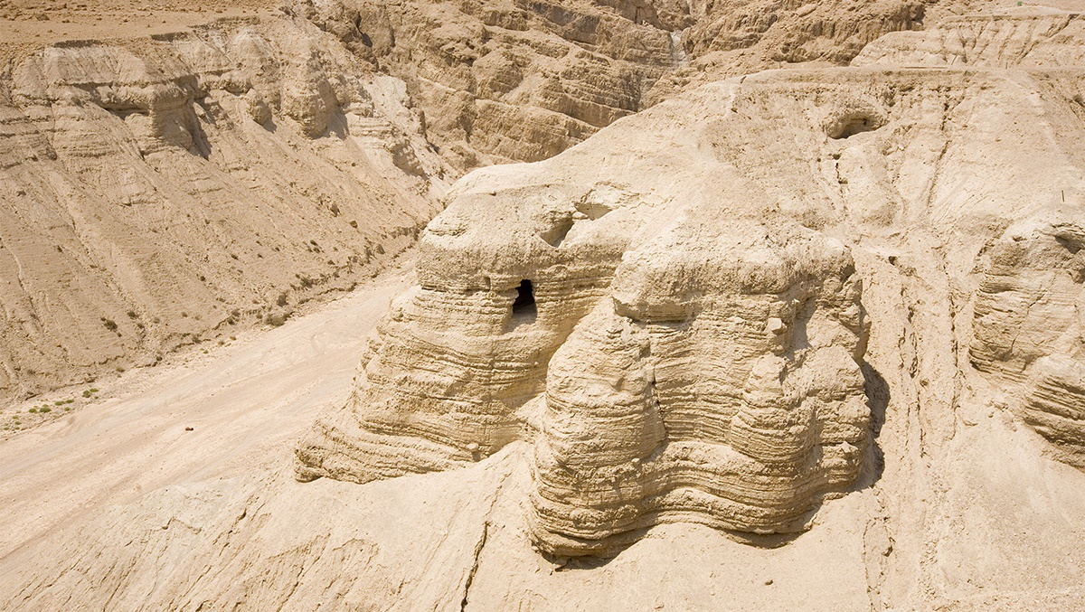
These Dead Sea Scroll Calendars …
Change the STRUCTURE of Yahuah’s Worship
calendar schedule through using intercalation.
THAT IS not only “a” problem,
but it is “THE” problem.
The Gregorian calendar “waiting days” after the
360th count, DO NOT CHANGE THE STRUCTURE of Yahuah’s QODESH WORSHIP Festal SCHEDULE!
56

Slide 57



So far:
A fair amount of calendar information has been examined.
In Part 6 of John 7
we will determine if this chapter holds another
“key” for our understanding.
Shalom!
questions@studythecalendar.com
57

